Slide 1
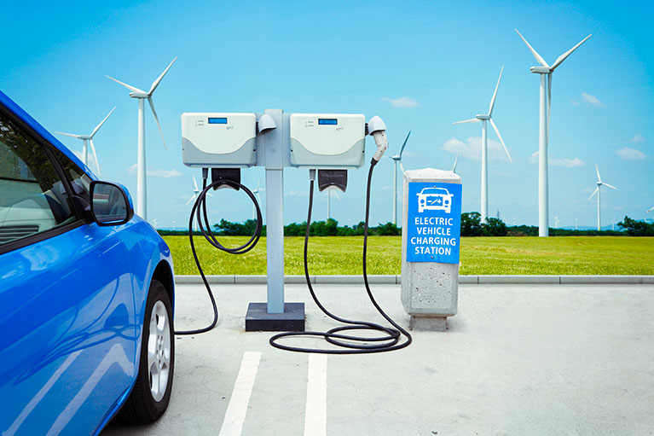
An Investigation into Electric Vehicle Charging Stations
Vanessa Van Gilder
Sam Stone
Esther Suh

Slide 2
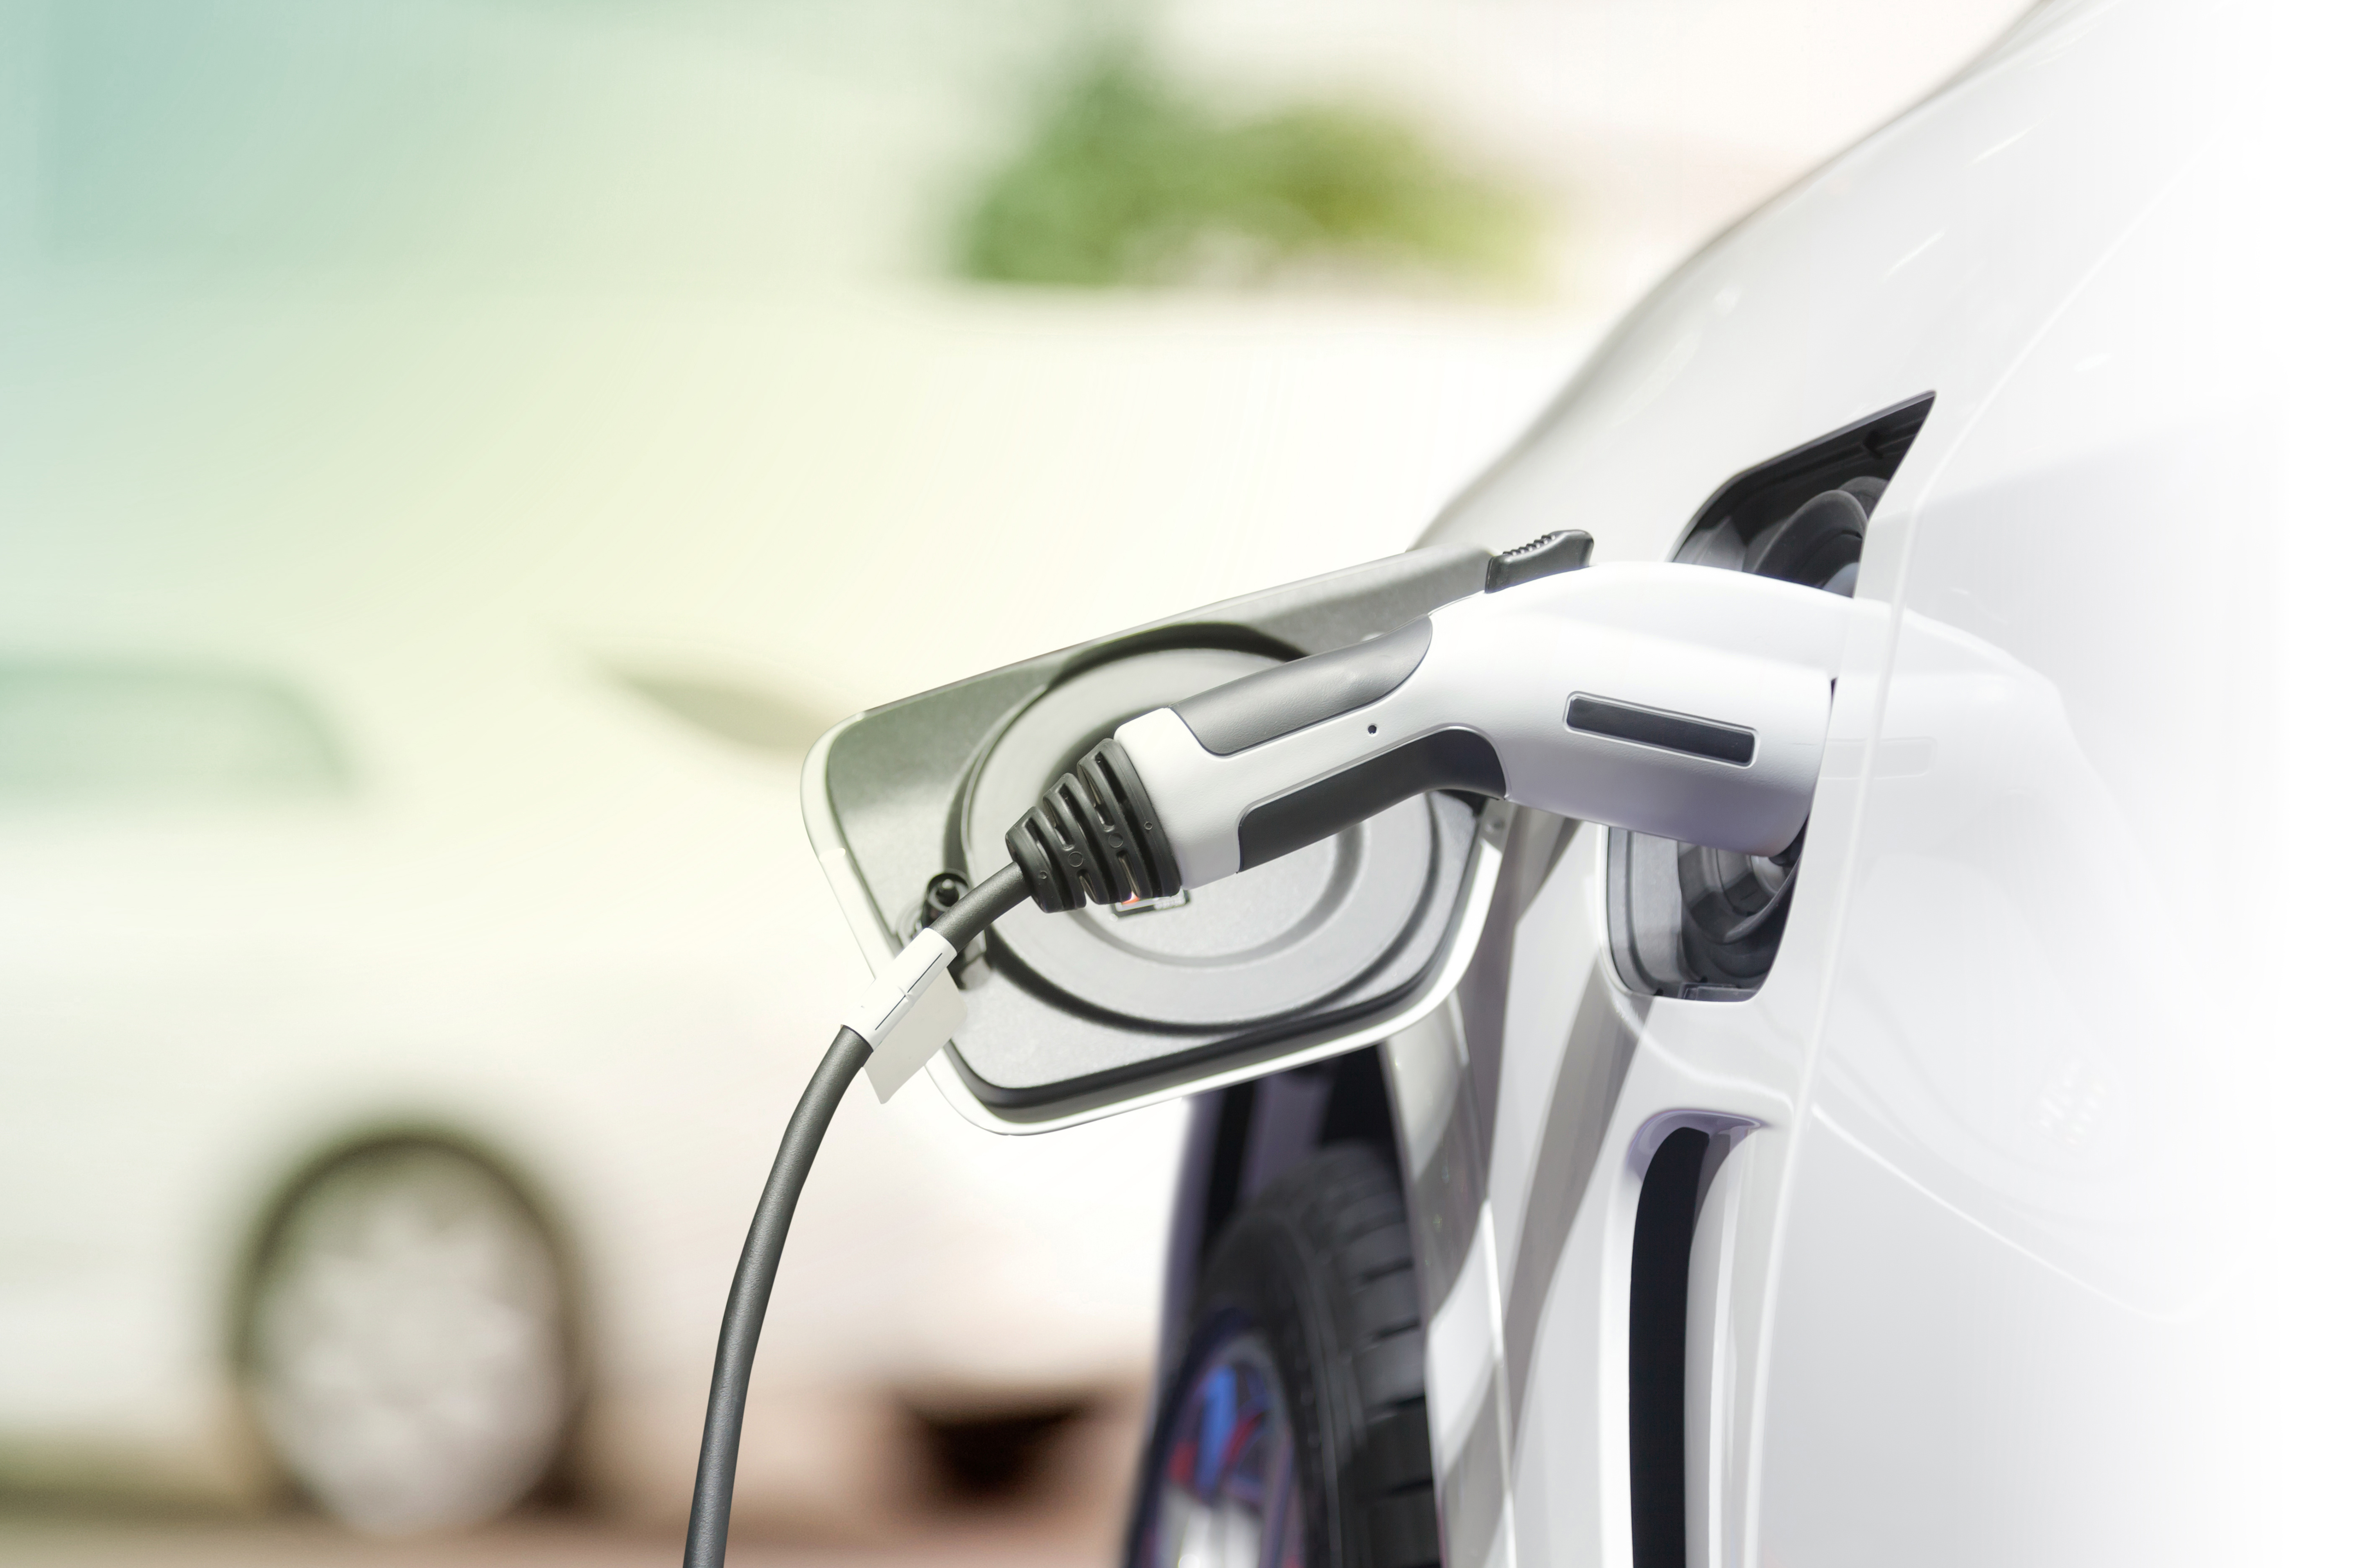
Why did we decide to study the number EV stations rather than the number of EVs?

Slide 3
Do these three factors affect the concentration and location of Electric Vehicle (EV) charging stations?
Average Adjusted Gross Income (AGI) by Zip Code
State EV incentives
State Gasoline Taxes

Slide 4
Data
IRS – Average AGI:
https://www.irs.gov/statistics/soi-tax-stats-individual-income-tax-statistics-2015-zip-code-data-soi
Alternative Fuels Data Center – Public EV Charging Station Data:
https://www.afdc.energy.gov/data_download
National Bureau of Economic Research – Nearest Zip Code: http://www.nber.org/data/zip-code-distance-database.html
US Zip Codes: https://www.unitedstateszipcodes.org/
U.S. Energy Information Administration – State Gasoline Tax: https://www.eia.gov/

Slide 5
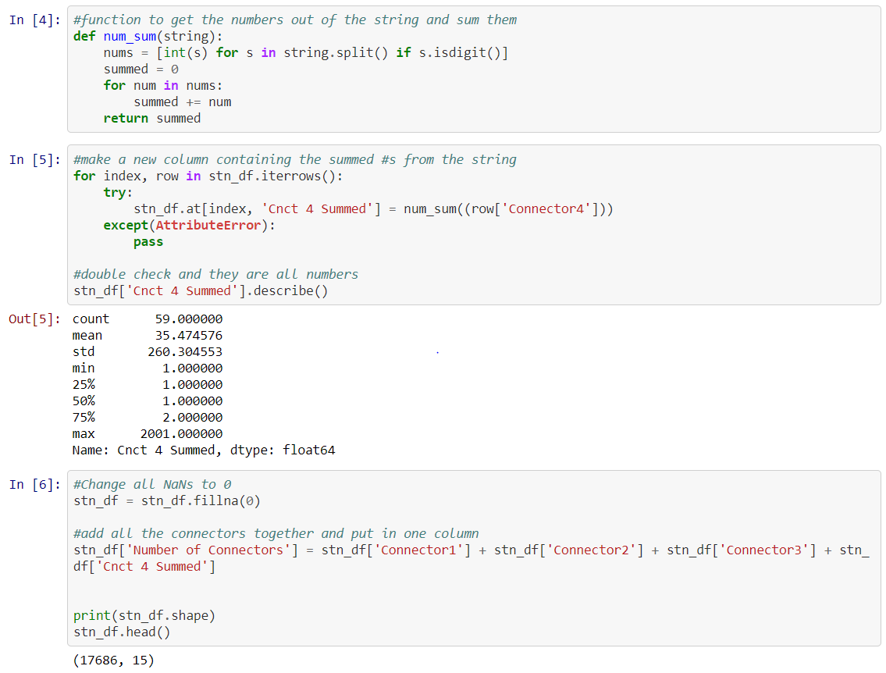
Data Exploration and Clean Up
https://github.com/VanessaVanG/GW_Project1/blob/master/data_exploration_cleanup.ipynb

Slide 6
MAPS on Plot.ly
EV Charging Stations with Average AGI
https://plot.ly/~VanessaVanG/0/ev-charging-stations-with-average-agi-by-zip-code-hover-for-average-agi/
State Incentives with Number of EV Stations and Connector Ports
https://plot.ly/~VanessaVanG/5/state-ev-incentives-with-number-of-stations-and-connector-ports/
State gasoline taxes and fees with Number of EV Stations and Connector Ports
https://plot.ly/~VanessaVanG/9/state-gasoline-taxes-and-fees-with-number-of-stations-and-connector-ports/

Slide 7
Data Analysis/Conclusions
1) Average AGI by Zip Code
We found more charging stations in the major metropolitan cities of the state: Silicon Valley, LA, New York, Austin, where most of the population live
2) State incentives:
the line of regression shows the correlation between number of stations and number of incentives.
3) State Gas Tax and Fees:
shows the weakest correlation per the scatter plot

Slide 8
Further Considerations
The other factors we would consider for future investigation:
• Population density
• the number of charging stations throughout a period of time
• Number of electric cars purchased over time
California is worth studying on its own due to its very high number of stations. If it the influencing factors can be determined, they can possibly be applied in other states to increase the number of EV stations/EVs.

